Slide 1
Introduction to Kinect For Windows SDK 1.8
Aug 2013

Slide 2

Agenda
What’s in v1.8
HTML5/Javascript
Kinect Fusion with Optional Color
New / Update Samples
Q&A

Slide 3
What’s in v1.8
Colors
HTML5/Javascript
Leverage your skills and tools from the Web world to build Kinect apps
Kinect Fusion with Optional Color
Build colorful 3D model with Kinect
New Samples
Background Removal Basics
Kinect Fusion Explorer Multi-Static Cameras

Slide 4
HTML5/Javascript

Slide 5
HTML5/Javascript – Why?
Colors

Slide 6
HTML5/Javascript - Overview
Colors
Delivering two things
Web Server
CSS + Javascript files
Server is extensible (e.g. add voice)
Easy to do simple things (buttons, etc…)
Possible to do very sophisticated things

Slide 7
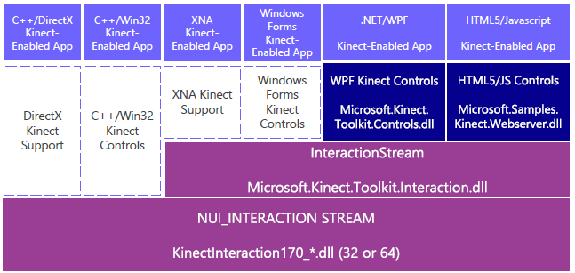
HTML5/Javascript - Overview
Colors

Slide 8
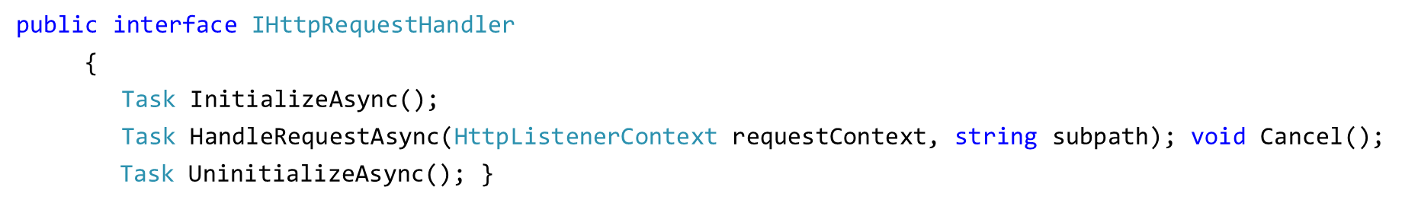
HTML5/Javascript – Code Walkthrough
Colors

Slide 9
Kinect Fusion with Optional Color

Slide 10
New / Update Samples

Slide 11
Q&A

Slide 12
Thanks !

